Slide 1



Slide 2


Slide 3

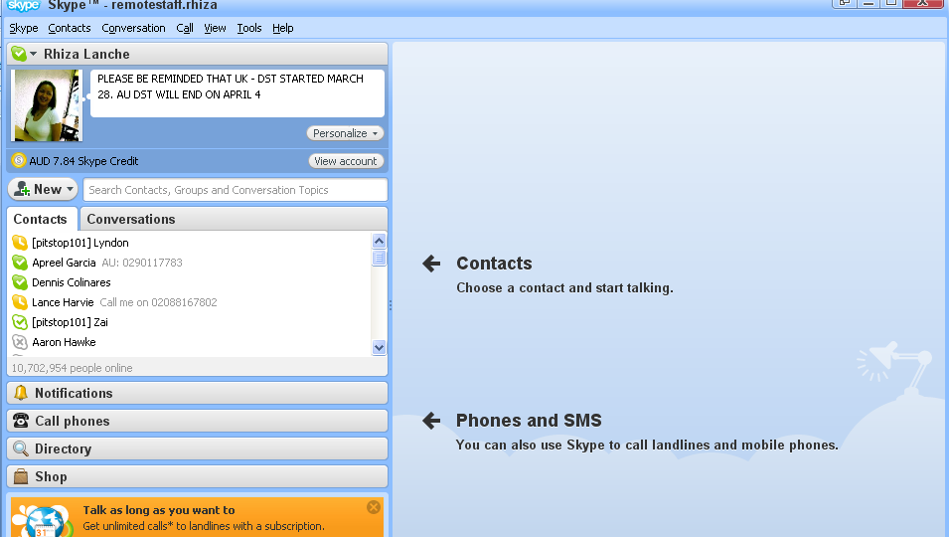
Put add-ons to your Skype
place your recent photo

Slide 4

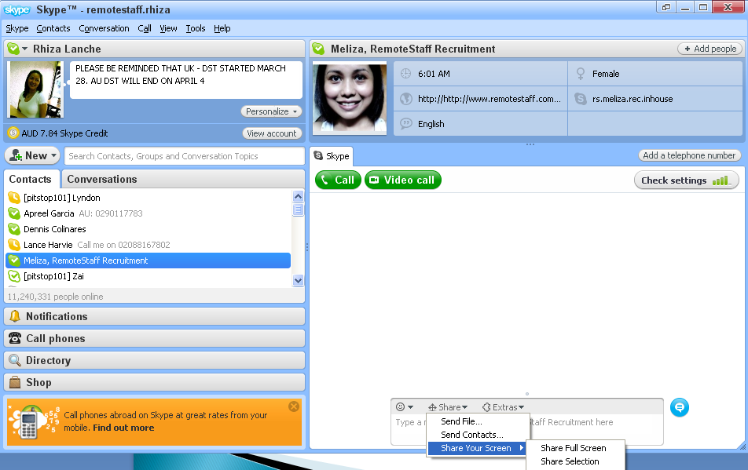
use Skype as a form of communication for clients. Staff members and remotestaff admin contacts
Download your Skype here.
Religiously log in to Skype while you are at work.
Make sure to acknowledge messages via Skype ASAP
You can use Skype to do a screen sharing activity, send files and send existing contacts from your Skype list
Click on share option of your window and click on the action you want to do.

Slide 5

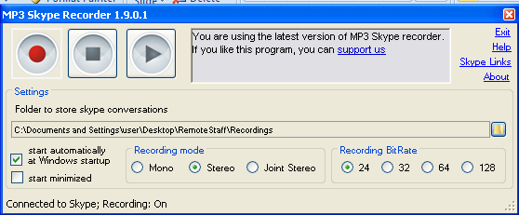
Create a folder to save all Skype call recordings
All calls can be recorded in Skype. Click here to download your own Skype recorder.
  Download and install the Skype recorder
  Log out from Skype as soon as the installation is done
  Restart your computer and log back in from Skype. The application will ask for your permission to access your Skype. Please allow it.
  A pop up should appear to indicate a successful installation
  All calls are automatically recorded and can be saved in a folder. This recording could be sent to you client or colleagues for training and for whatever purpose it can serve.

Slide 6


Slide 7

Google docs is a tool that can be used to share documents to your client or/and colleagues. The files are hosted online which protects you from loosing files. This is also a good and easy way to collaborate with your client as it can be updated real time by yourself and other people who have access to the file.
It is accessible anywhere as long as you have internet connection.
Click here to sign up for google docs. Use your existing company gmail account.
As soon as you are logged in to google docs, you can now create and/or upload documents you want to share to respective staff members. Click here to view.
Invite the people you want to view the documents you created. You can also set restrictions to your document. Click here
Notifications for edit, additional inputs, etc can be send to your email by customizing notification rules, click here

Slide 8
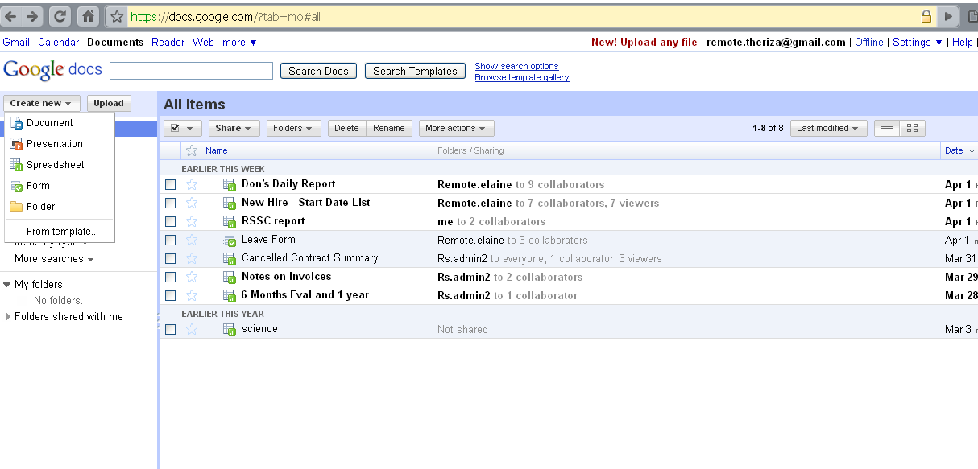
Click here to create new document
Click here to upload an existing document

Slide 9
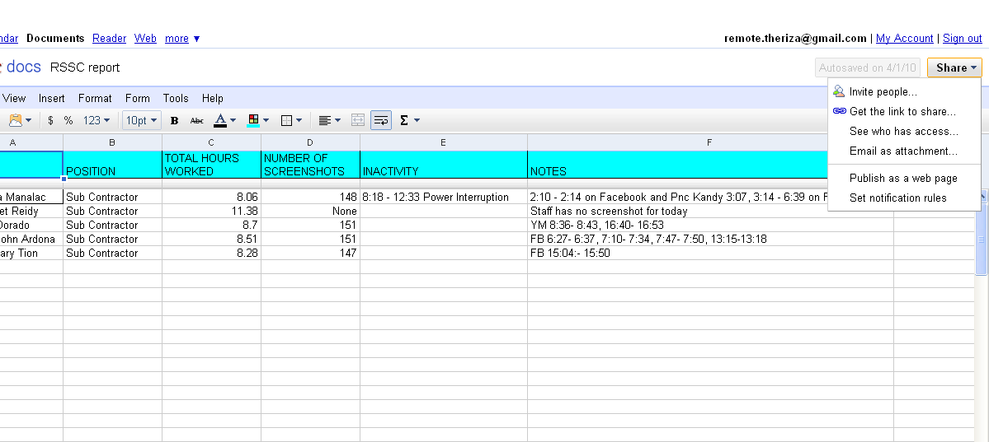
Click and select the people you want to see the documents
Set restrictions to your documents.
Set your notification rules

Slide 10

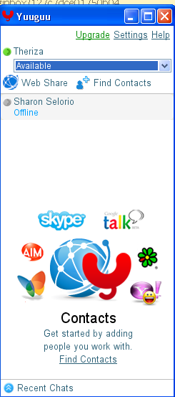

Slide 11

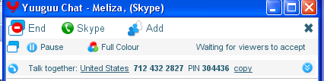
Yuuguu can be used as a screen – sharing tool which means that you can show your screen to your clients and colleagues while on the phone with them. You can also get them to control your mouse if and when needed.
Great tool for training and meetings.
Click here to download yuuguu.
Download and install yuuguu. Once installed, sign up to create your yuuguu account. Click here
To start your secure screen sharing session, just click on the person you want and then click on 'Show‘.. Give the PIN code you will see on the pop up window
If the person you are going to have a yuuguu meeting doesn’t have a yuuguu account or not on your list, simply click on the “wed share” link just below your names and then give the link and pin to the person you want to have a meeting with.
Ask the participant to accept the screen share invitation and type in the pin code to: http://www.yuuguu.com/share?pin=xxxxxx

Slide 12
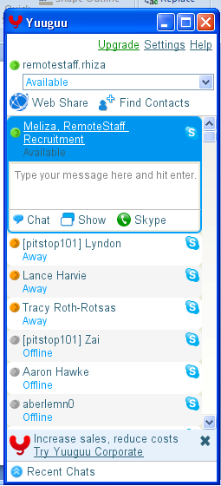
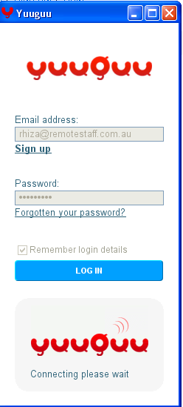
Create your yuuguu account
Show button

Slide 13

Click on the settings option.
Go the Skype tab then uncheck the first two boxes and then click next to finish integrating yuuguu with your Skype account
All contact list in your Skype will be imported to yuuguu.
To share your screen, click on the contact’s name then click on show and a notification link will be sent to the participant.
To control your participant’s screen,

Slide 14

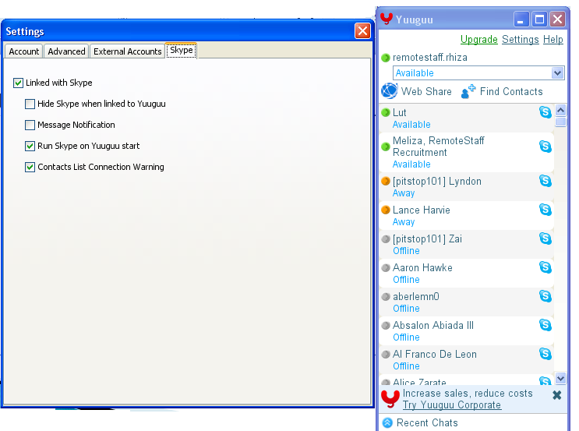
Click on this button to integrate yuuguu with Skype
Click on this button to customize yuuguu

Slide 15
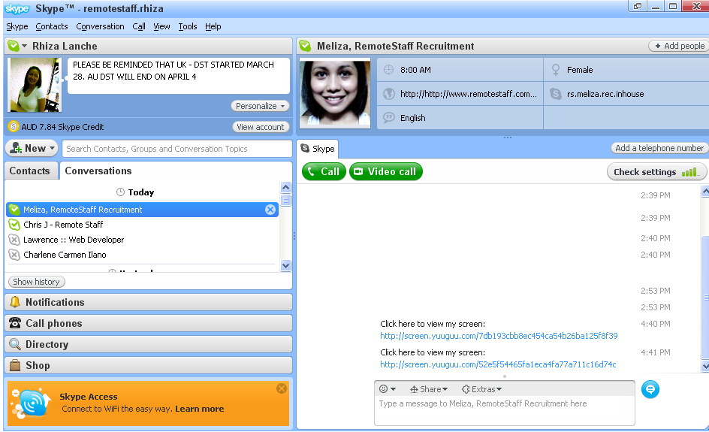
Yuuguu screen sharing notification link via Skype, email or phone.

